Slide 1
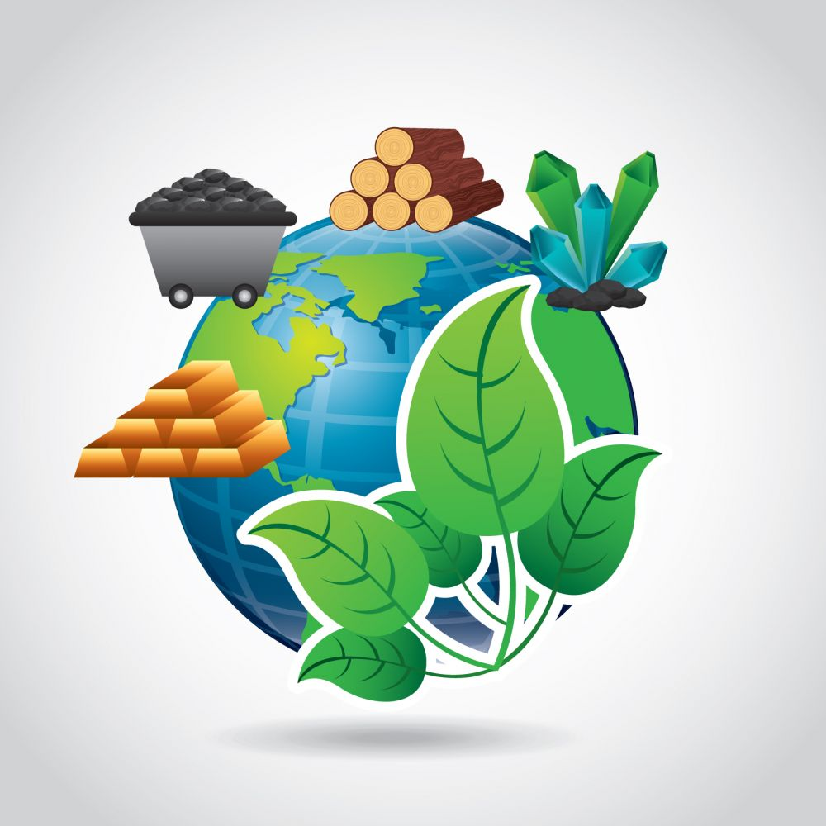
Daily Review
Earth’s Resources
A resource is any naturally occurring thing that can be used to satisfy the needs of humans or other living things.
Resources can be renewable, for example sunlight.
Resources can be non-renewable, for example coal.
Think, pair, share: What is the difference between a renewable resource and a non-renewable resource?
Vocabulary
renewable (adjective) a natural resource that either cannot be used up or can replenish itself when used non-renewable (adjective) a natural resource that can be used up and does not replenish itself (or replenishes very slowly)

Slide 2
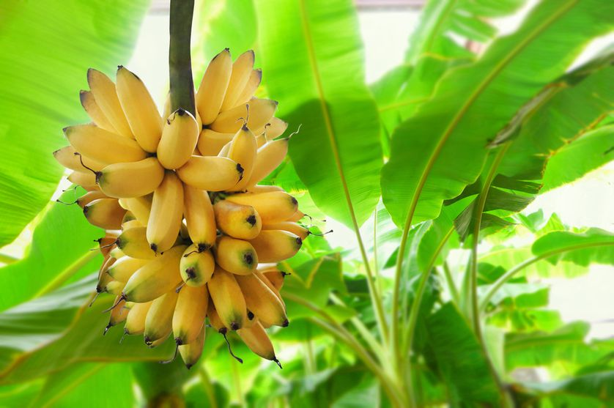
Daily Review
Renewable Resources
There are two types of renewable resources:
Continuous renewable resources, which can never run out
Non-continuous renewable resources, which can be used up but can come back over time
Think, pair, share: What is the difference between continuous and non-continuous renewable resources?
Think, pair, share: Would bananas be classed as a continuous or non-continuous renewable resource? Explain your choice.
Vocabulary
renewable (adjective) a natural resource that either cannot run out or can replenish itself when used

Slide 3
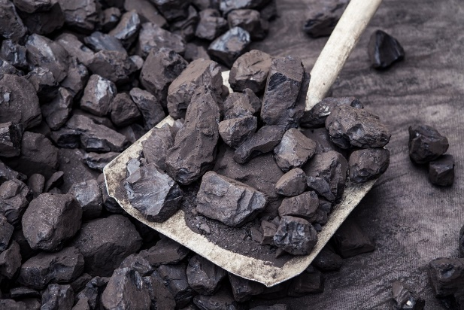
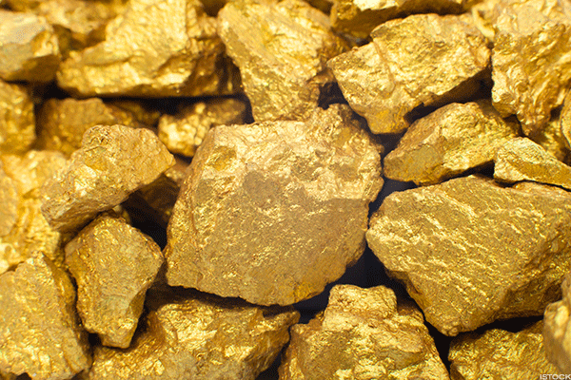
Daily Review
Non-renewable Resources
Non-renewable resources can run out: only a limited amount of them is available.
They cannot come back after they have been used (or they take an extremely long time to come back).
Think, pair, share: What is a non-renewable resource?
Think, pair, share: Why are coal and gold classed as non-renewable resources?
Vocabulary
non-renewable (adjective) a natural resource that can be used up and does not replenish itself (or replenishes very slowly)

Slide 4
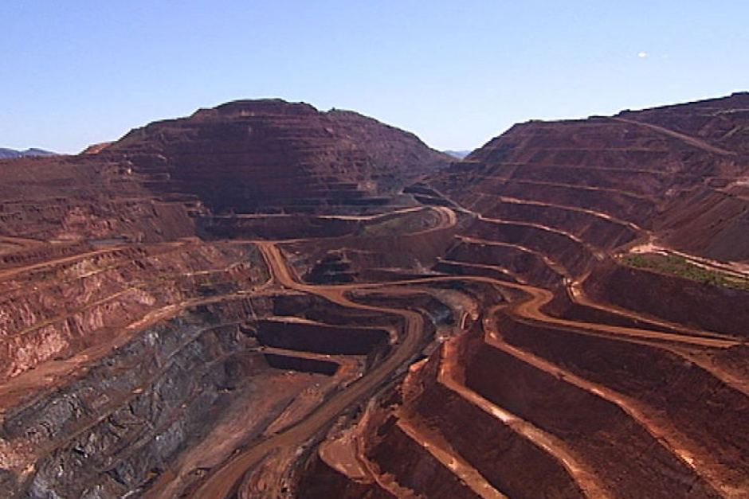
Daily Review
Vocabulary
renewable (adjective) a natural resource that either cannot be used up or can replenish itself when used non-renewable (adjective) a natural resource that can be used up and does not replenish itself (or replenishes very slowly)
Can this resource run out?
No: continuous renewable
If it can run out, can it come back quickly?
Yes: non-continuous renewable
No: non-renewable
What type of resource is iron?
We will run out of iron one day, and it cannot come back, so it is a non-renewable resource.

Slide 5
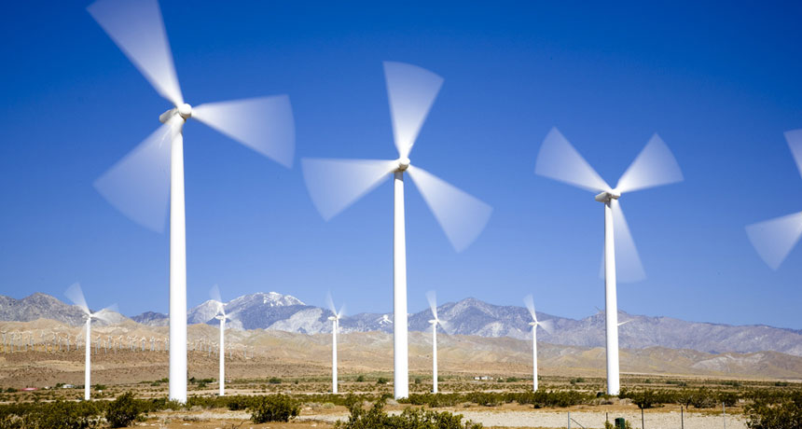
Daily Review
Vocabulary
renewable (adjective) a natural resource that either cannot be used up or can replenish itself when used non-renewable (adjective) a natural resource that can be used up and does not replenish itself (or replenishes very slowly)
Can this resource run out?
No: continuous renewable
If it can run out, can it come back quickly?
Yes: non-continuous renewable
No: non-renewable
What type of resource is wind?
Wind cannot run out, so it is a continuous renewable resource.

Slide 6
Renewable Resources Year 7 Science

Slide 7
Learning Objectives
Describe different types of renewable resources.
Identify advantages and disadvantages of renewable resources
CFU 1
What type of resources will we be learning about today?
Activate Prior Knowledge
On your whiteboard, name two renewable resources and state how humans use them.

Slide 8
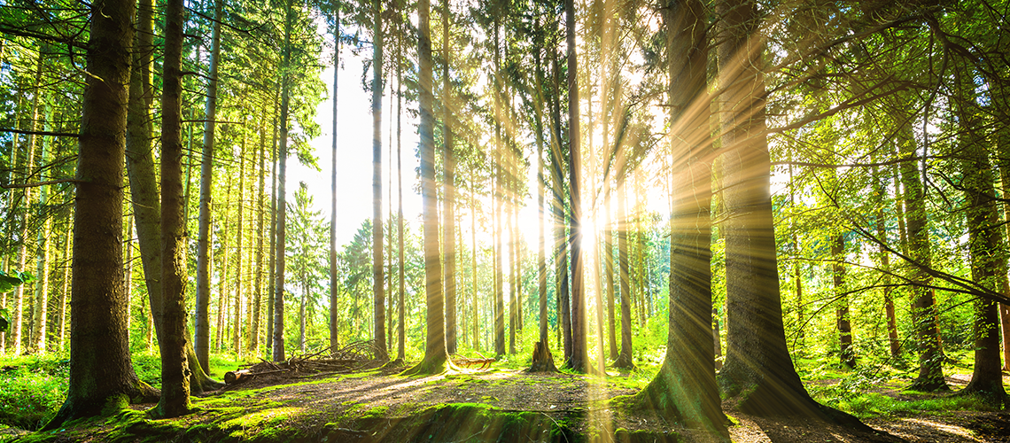
Concept Development
CFU 1
What makes a resource renewable?
Renewable Resources
Renewable resources either cannot run out or replenish themselves quickly.
They be continuous (which will never run out) or non-continuous (which can be used up but will return over time)
CFU 2
Name three resources that are renewable.

Slide 9
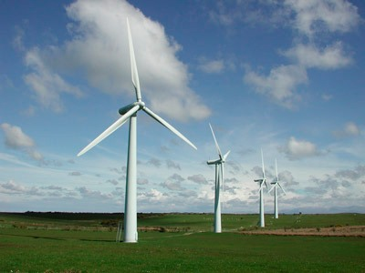
Concept Development
CFU 1
Why are we using more renewable resources?
Advantages of Renewable Resources
Many countries are moving towards using more renewable resources.
Some of the advantages of using renewable resources are:
They are not going to run out (or will replenish quickly)
They do not cause pollution to air and water

Slide 10
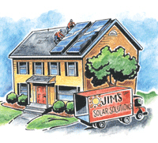
Concept Development
CFU 1
What are some disadvantages to using renewable resources?
Disadvantages of Renewable Resources
While most renewable resources reduce pollution, they have some disadvantages.
Some of the disadvantages of using renewable resources are:
They can be dependent on weather
They can cause damage to the environment when they are built
They can be costly to build and maintain

Slide 11
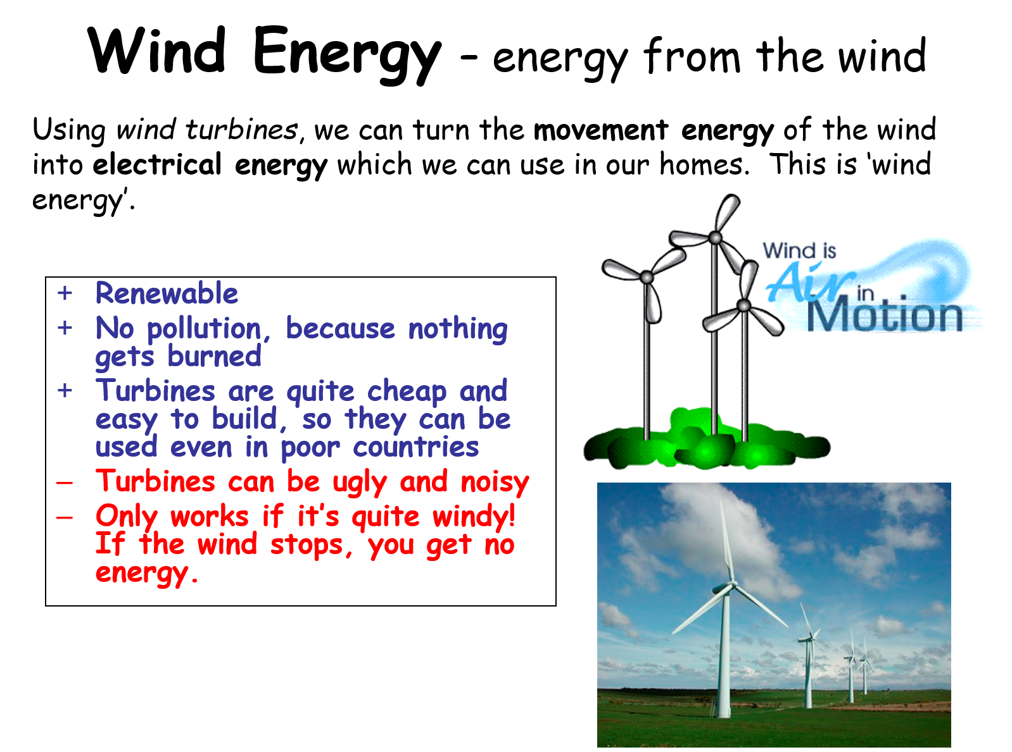
Skill Development / Guided Practice
Filling out your graphic organiser
You need to include the following information on your graphic organiser for each non-renewable resource
Where the energy comes from
How it works
Advantages
Disadvantages

Slide 12
Independent Practice
Use the information on the cards provided to complete the graphic organiser.

